Slide 1


Cipher Net

Slide 2

Presented By
Het Patel (002624454)
Jay Parekh (002642830)
Ronak Mahidharia (002624454)
Sai Suraj Suravajhala (002624454)

Slide 3


Agenda Overview
01
Purpose
05
Flow Diagram
02
Features
06
Tools Used
03
Contributions
07
Difficulties Faced
04
Tech Stack
08
Future Scope

Slide 4


Purpose
Mainstream web browsers often undermine user privacy by engaging in unsolicited data collection and website tracking, compromising the security and trust of users.
Our project, Cipher Net, aims to redefine online privacy by creating a browser that empowers users with complete control over their digital footprint. By prioritizing transparency and eliminating tracking mechanisms, we enable individuals to browse securely and confidently without worrying about intrusive surveillance or data misuse.

Slide 5




Features
We aim to redefine the browsing experience by prioritizing user privacy, simplicity, and efficiency. Cipher Net provides innovative tools for secure and user-friendly web exploration.
Advanced Privacy Controls
Enable or disable script tracking for a secure and personalized browsing experience.
User-Friendly Interface
Intuitive design ensures ease of use for users of all technical levels.
Integrated Productivity Tools
Includes bookmarks and a quick notepad for seamless browsing and organization.

Slide 6


Contributions
Het | Jay | Ronak | Suraj
Rendering Web Results | Quick Notes | Bookmarks | Privacy Controls
JavaScript Blocking | History Management | Multi-tab Functionality | Cache Management

Slide 7

Tech Stack
Utilizing a combination of modern development tools and technologies, Cipher Net ensures a seamless, secure, and user-friendly browsing experience. The chosen stack supports robust functionality and efficient performance.
Java Development Kit (JDK)
JavaFX SDK
Core technology required to develop Java applications, including JavaFX.
Provides libraries and tools to build JavaFX applications, including runtime and packaging tools.
Eclipse IDE
JavaFX Libraries
Comprehensive development environment for writing, testing, and debugging JavaFX code.
APIs for creating rich client applications with features like graphics, media, and controls.
CSS
A style sheet language for designing UI components in JavaFX.

Slide 8
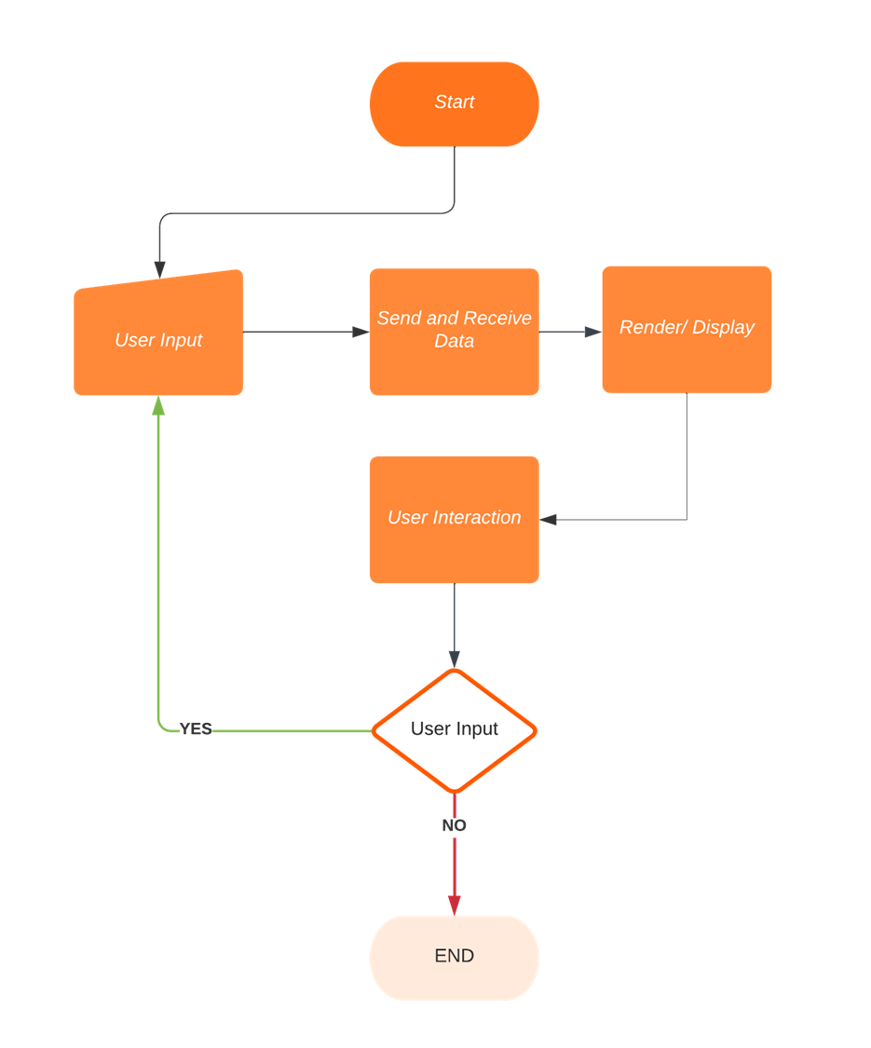
Flow Diagram

Slide 9





Concepts Covered
Key Contributors
Ronak Mahidharia
JavaFX: For building modern user interfaces with advanced graphical support.
Class Definitions: Structure and behavior of objects within the application.
Polymorphism: Flexibility through a single interface supporting various forms.
Inheritance: To manage shared logic across multiple features or components in the project
Interfaces & Abstract Classes: To define multiple functionalities without implementation and abstract classes provide a base structure, leaving implementation details to derived classes.
Arrays and ArrayList: Implemented for static data storage and manipulation.
Collections: Provided ready-to-use data structures for effective data management.
Focused on implementing JavaFX for the user interface.
Jay Parekh
Worked on object-oriented principles such as polymorphism and class structures.
Het Patel
Ensured seamless integration of Collections and interface abstractions.
Suraj Suravajhala
Developed and optimized data structures, including Array and ArrayList.

Slide 10
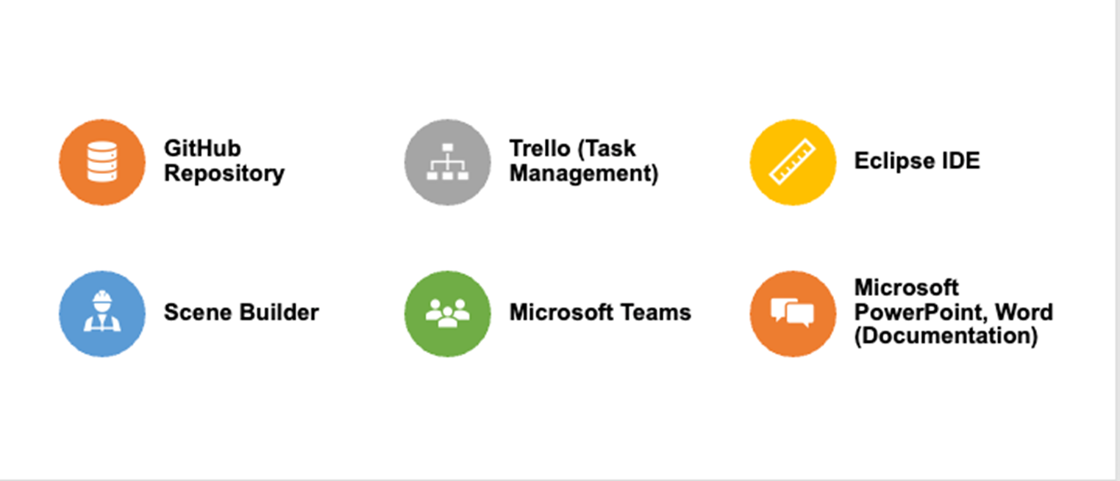
Tools Used

Slide 11
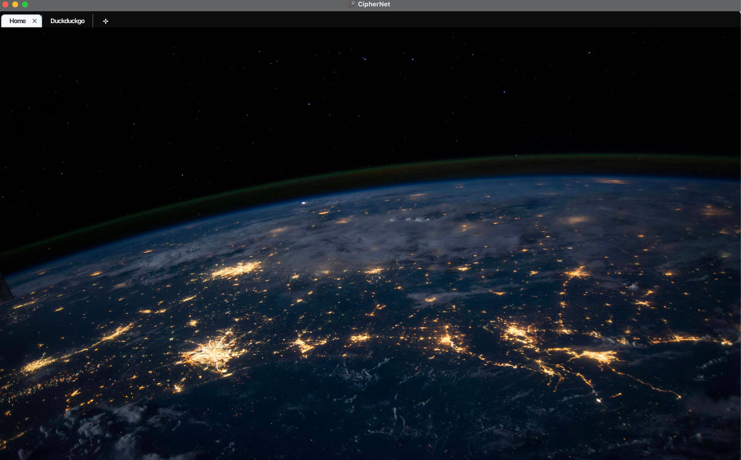
Homepage
UI

Slide 12
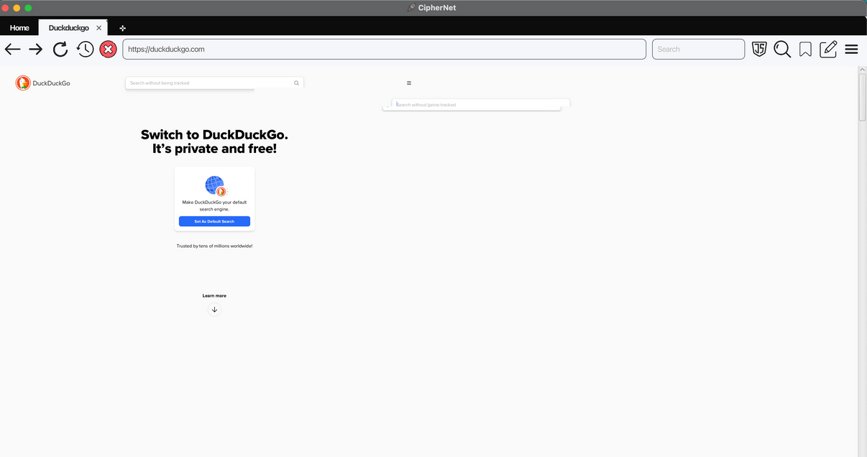
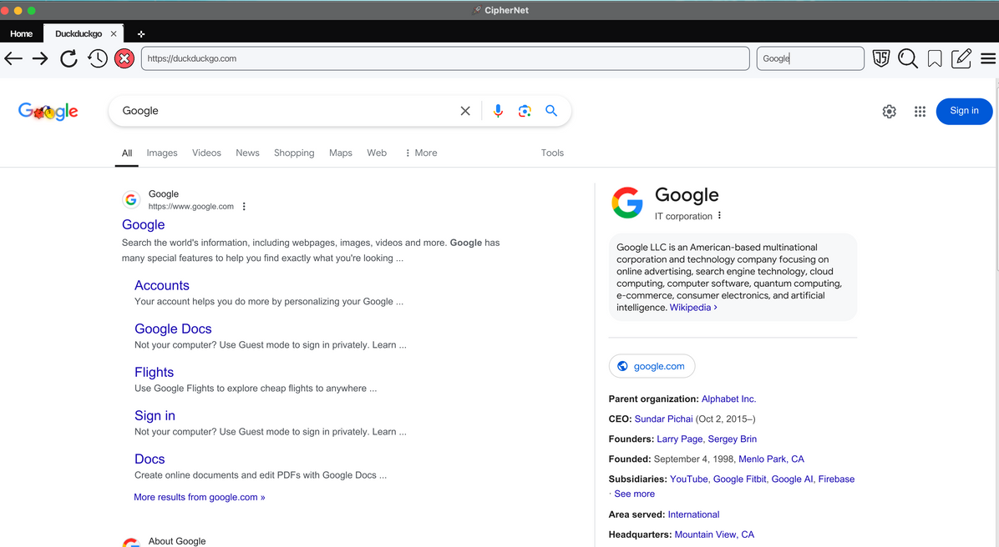
New Tab UI
Normal Search UI

Slide 13
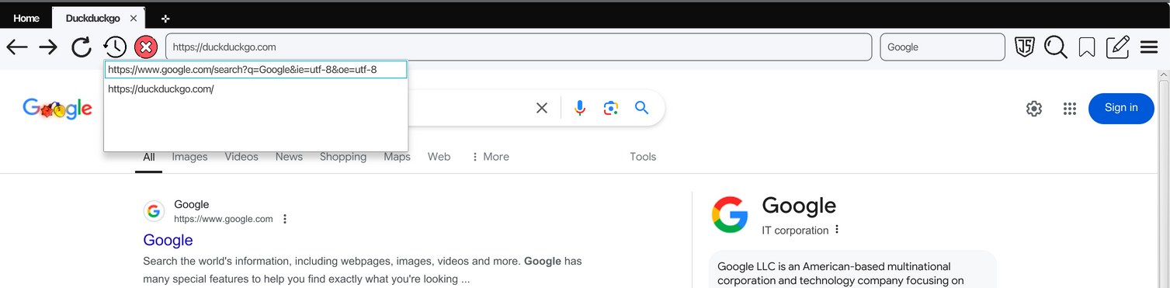
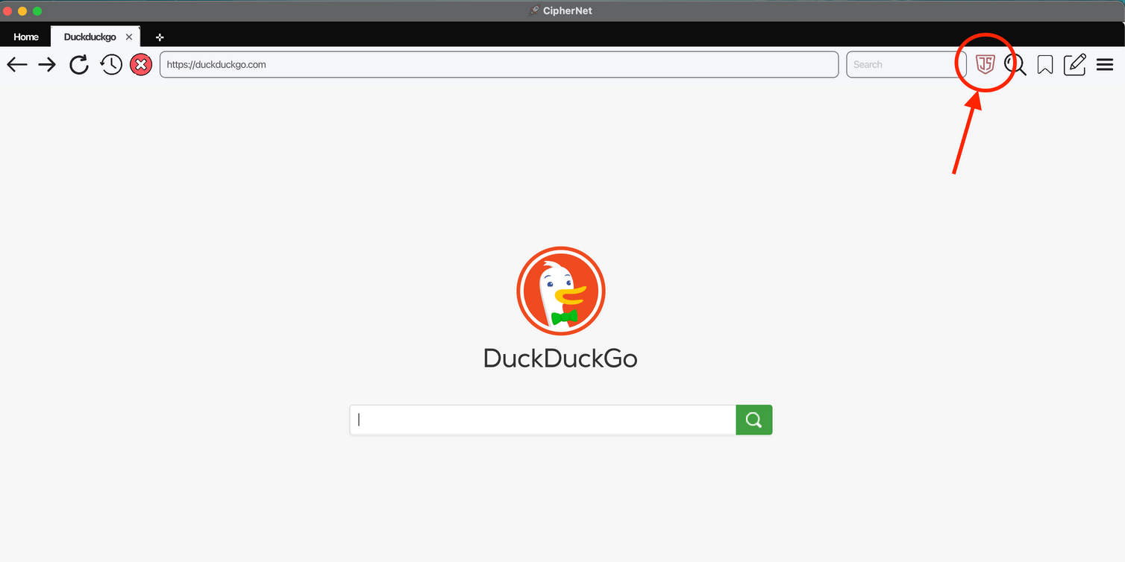
Quick History
No Tracking Disable UI

Slide 14
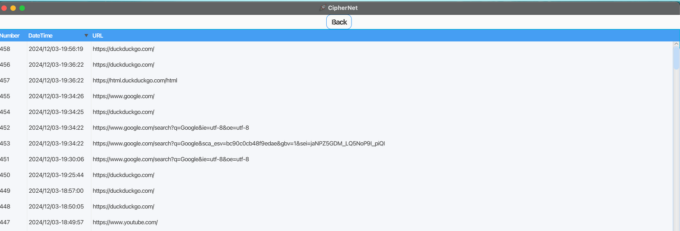
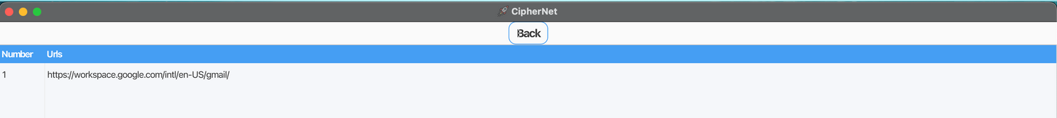
History
Bookmarks

Slide 15
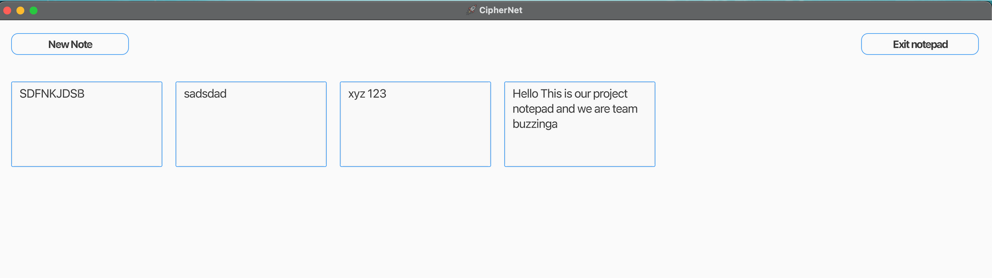
Note pad

Slide 16
Difficulties Faced
We encountered several challenges while developing Cipher Net to ensure a seamless and secure browsing experience.
Rendering Web Results with Low Latency
Achieving a fast and responsive web browsing experience without compromising functionality.
Blocking JavaScript of Websites
Implementing effective mechanisms to block JavaScript selectively while maintaining compatibility with essential features.
Creating Multiple Tabs in the Same Scene
Developing a robust multi-tab functionality while preserving smooth user interaction and performance.

Slide 17
Future Scope
Cipher Net aims to evolve beyond its current functionalities by incorporating advanced features and extending its platform.
Login Feature for Users
A secure login system will enable personalized user experiences and data synchronization.
Mobile Application Extension
Cipher Net will be developed into a mobile app, providing a seamless browsing experience across devices.

Slide 18

Thank You

